Slide 2

Topics
Basic String Operations
String Slicing
Testing, Searching, and Manipulating Strings

Slide 3
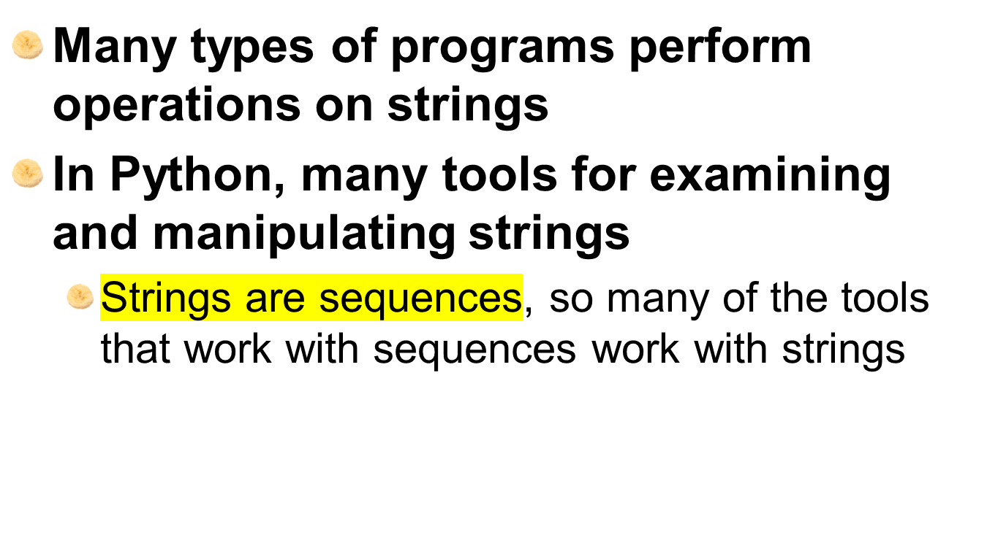
Basic String Operations

Slide 4
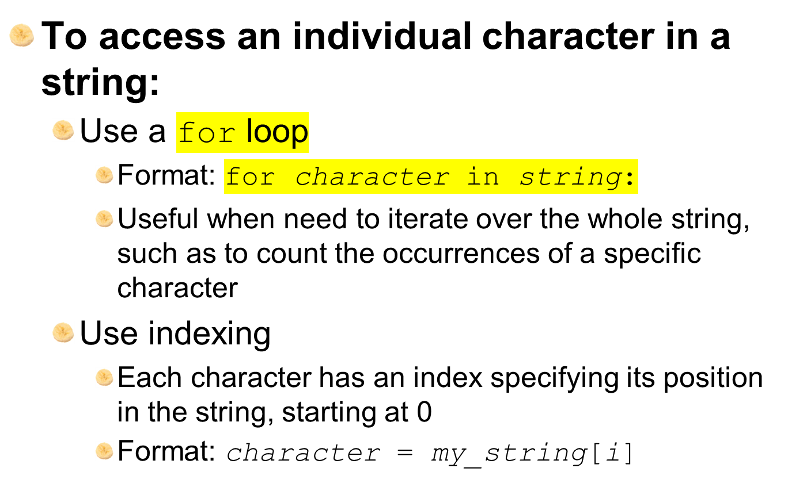
Accessing the Individual Characters in a String

Slide 5
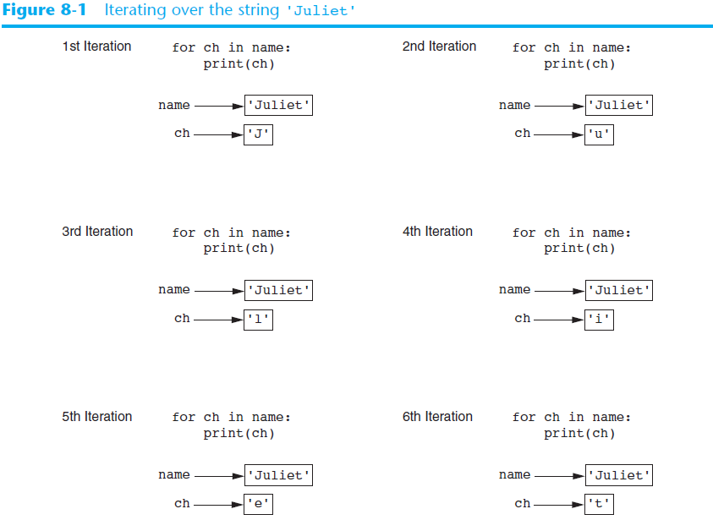

Slide 6


Accessing the Individual Characters in a String (cont’d.)
Notes:
We cant do my_string[2]=‘r’ since it is immutable

Slide 7
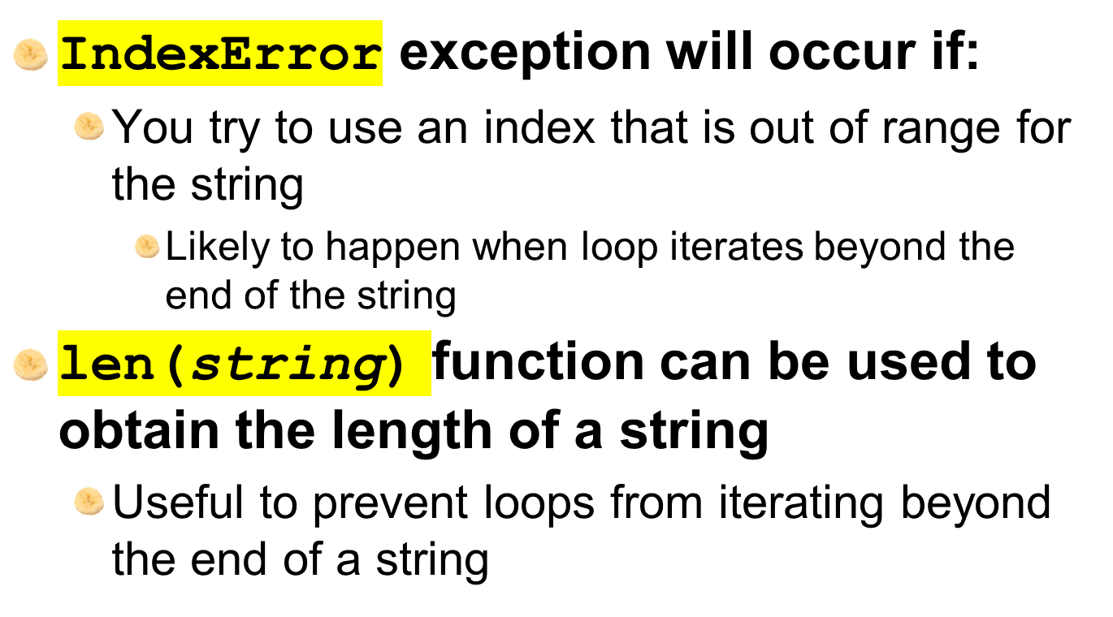
Accessing the Individual Characters in a String (cont’d.)

Slide 8
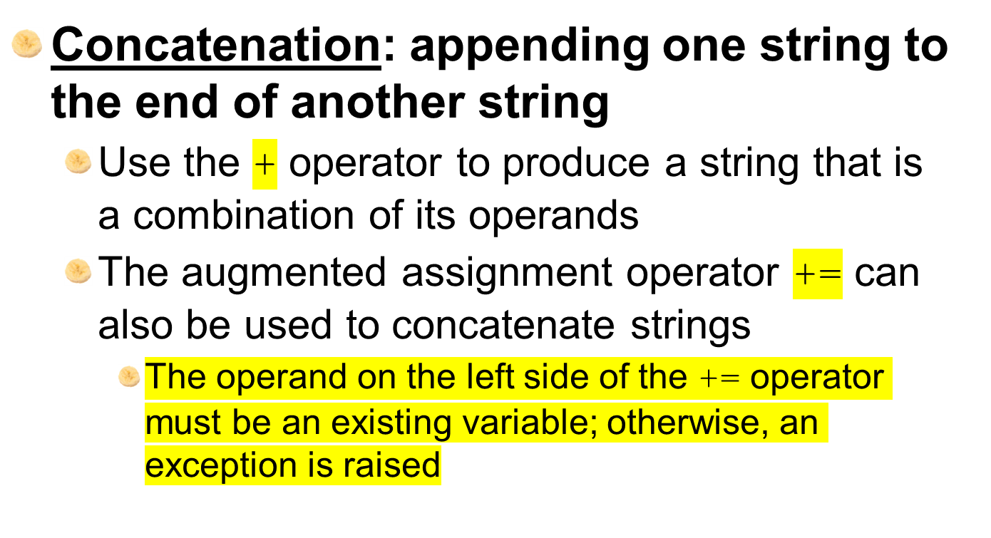
String Concatenation

Slide 9
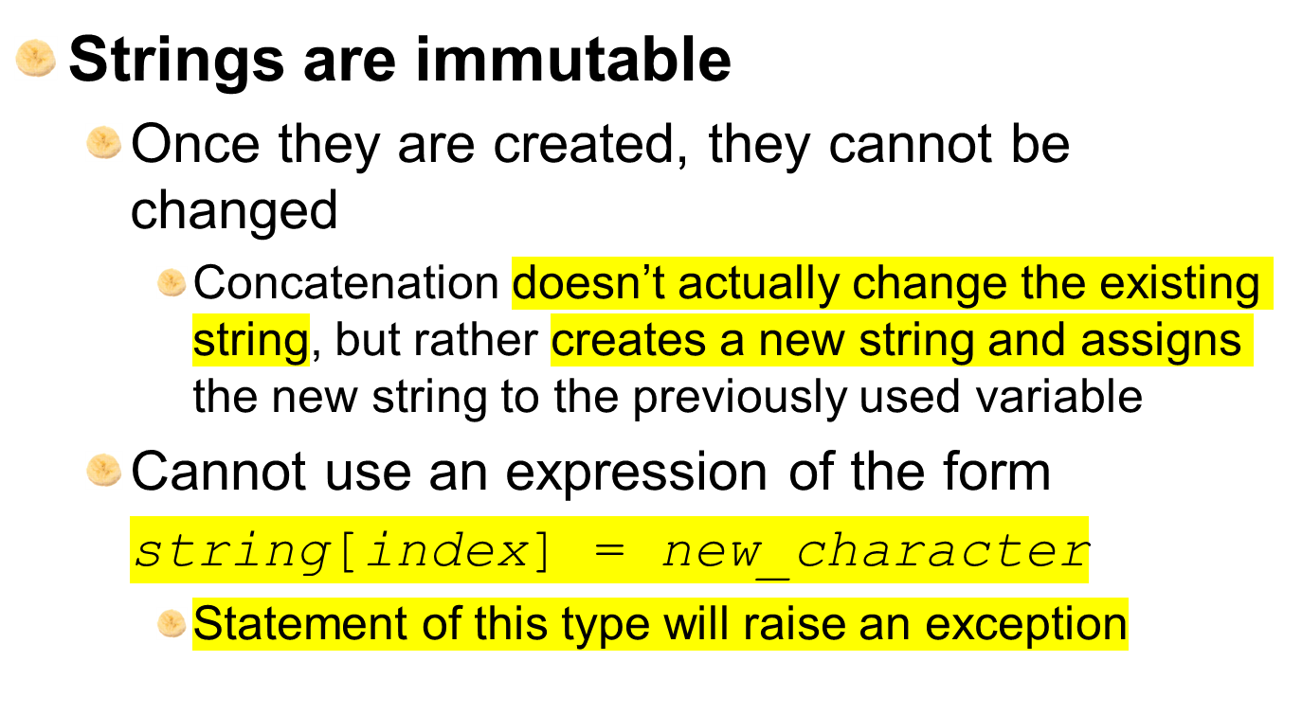
Strings Are Immutable

Slide 10
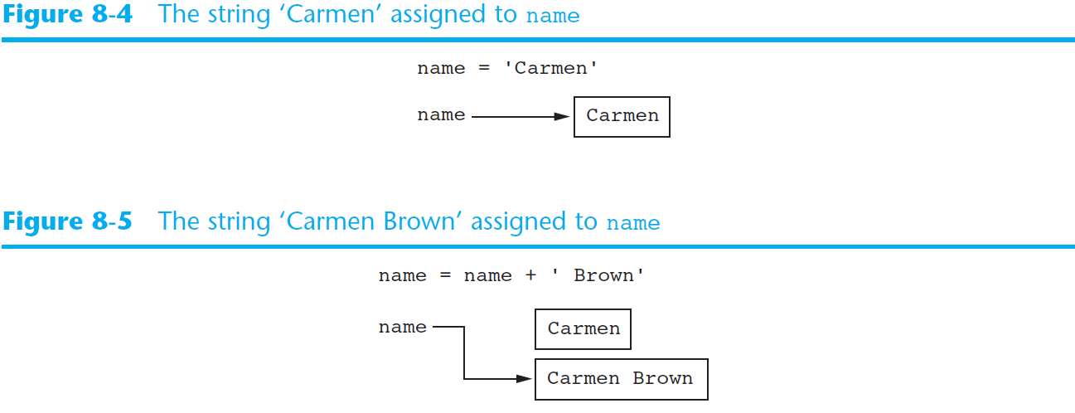
Strings Are Immutable (cont’d.)

Slide 11
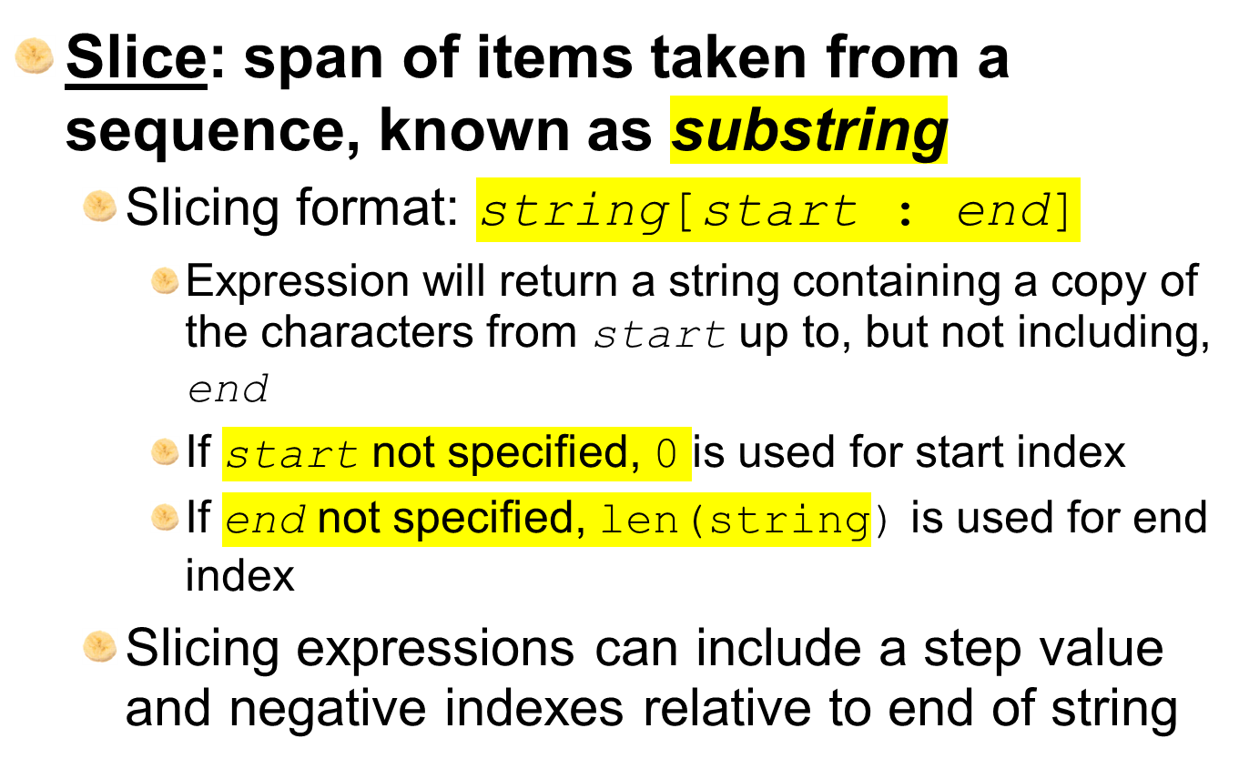
String Slicing

Slide 12
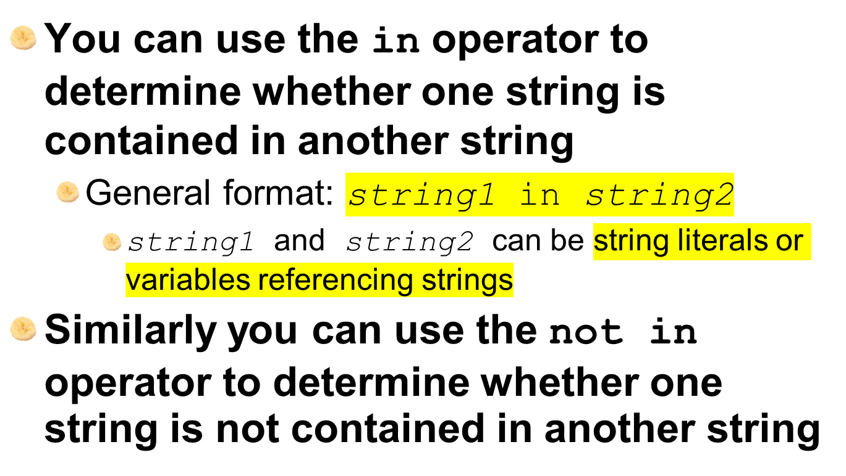
Testing, Searching, and Manipulating Strings

Slide 13
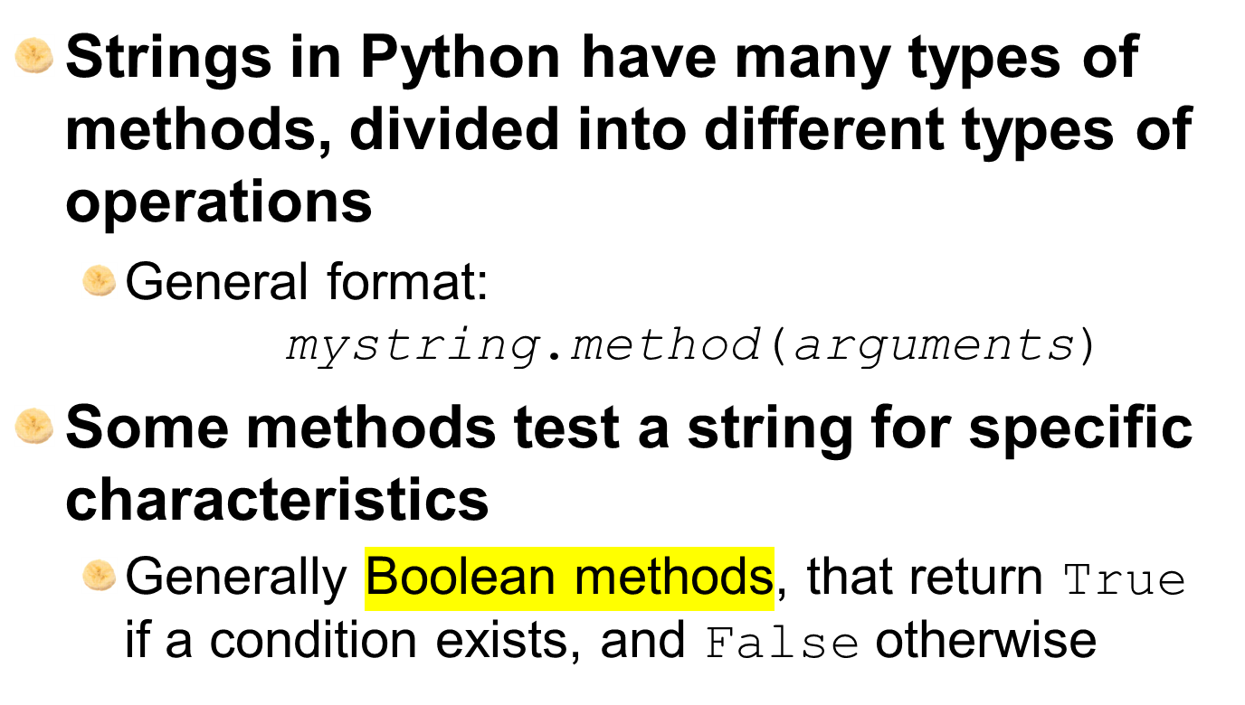
String Methods

Slide 14
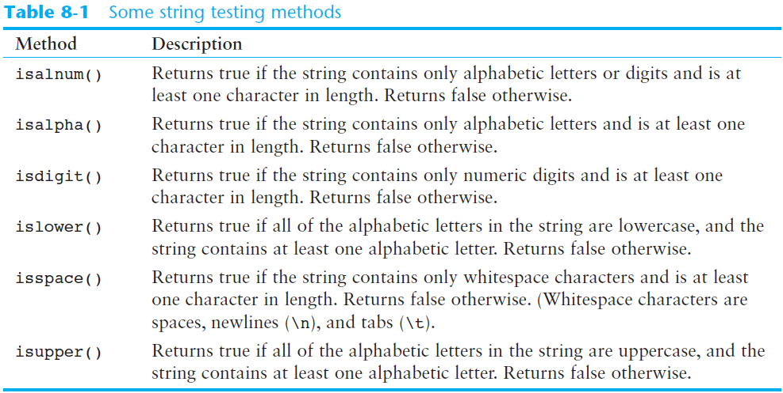
String Methods (cont’d.)
Notes:
These methodes create new string and references new string.

Slide 15
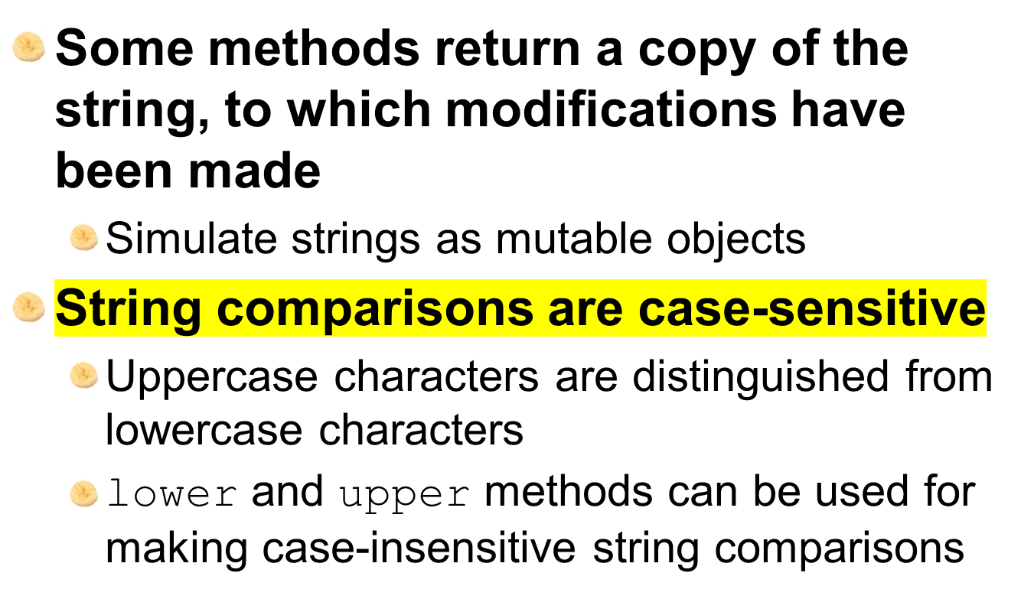
String Methods (cont’d.)

Slide 16
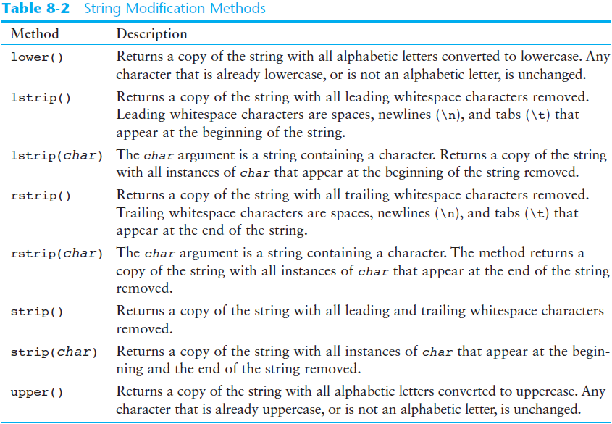
String Methods (cont’d.)

Slide 17
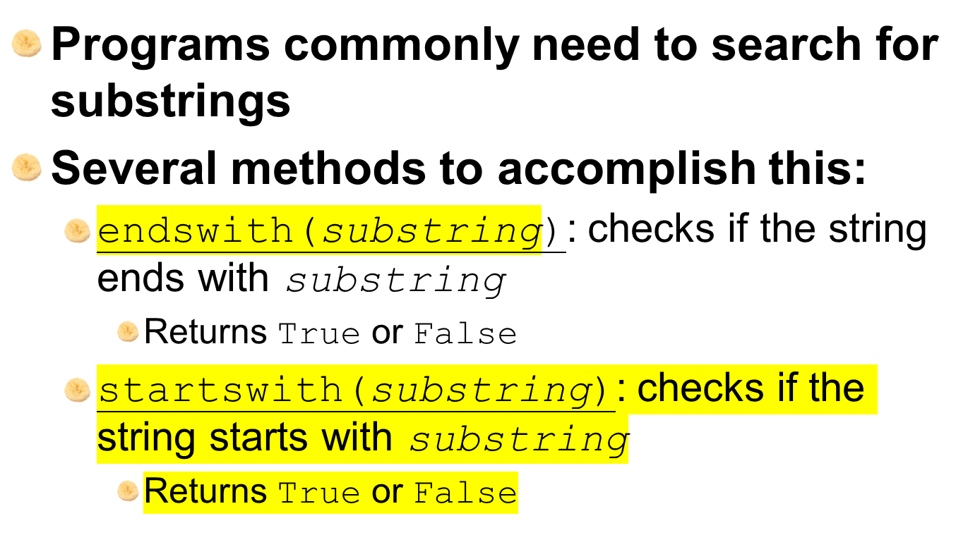
String Methods (cont’d.)

Slide 18
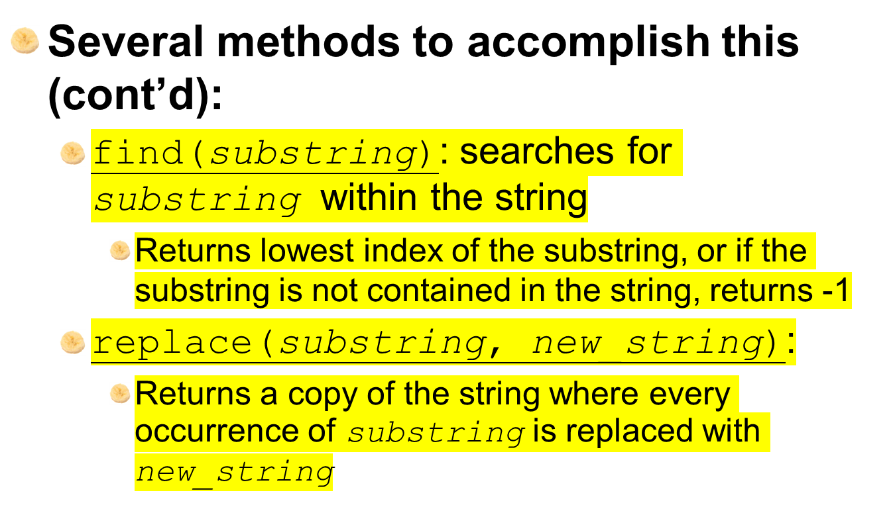
String Methods (cont’d.)

Slide 19
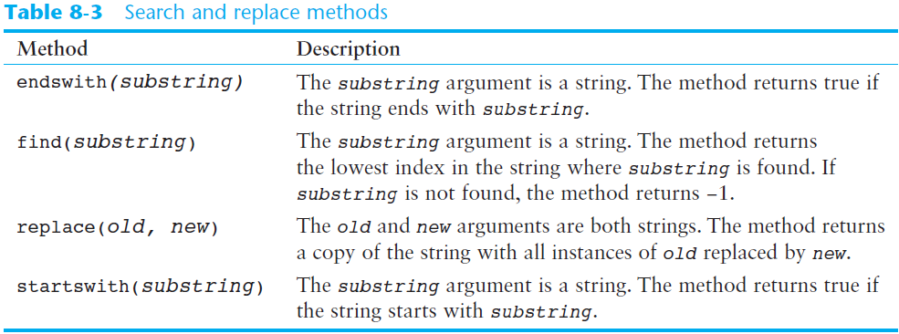
String Methods (cont’d.)

Slide 20
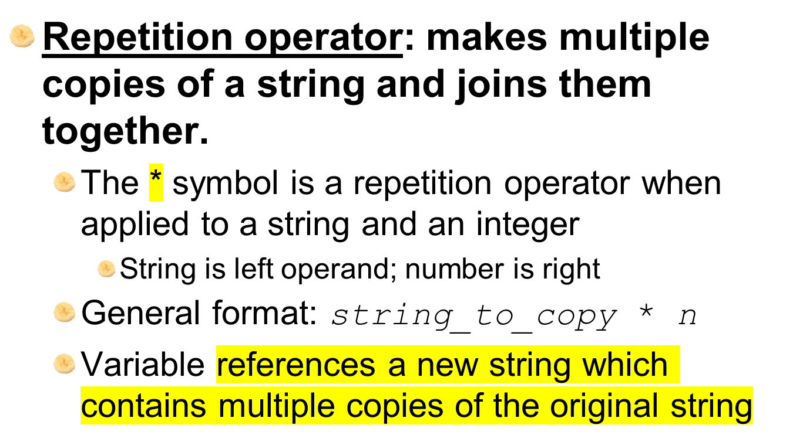
The Repetition Operator

Slide 21
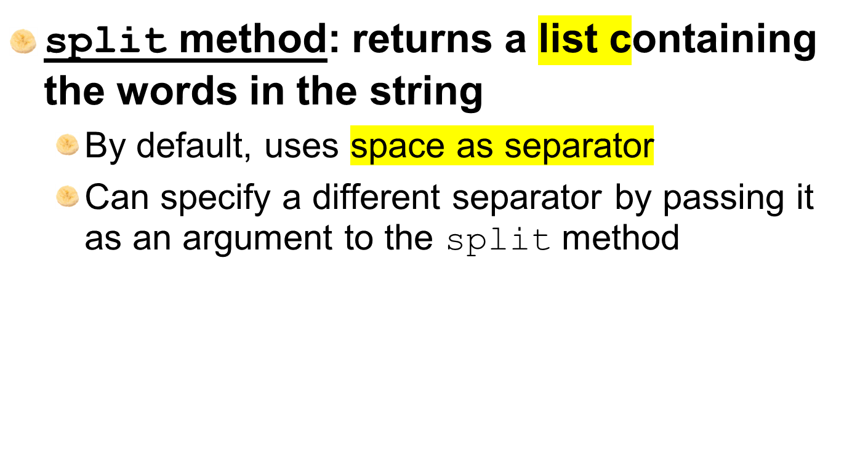
Splitting a String

Slide 22
Summary
This chapter covered:
  String operations, including:
    Methods for iterating over strings
    Repetition and concatenation operators
    Strings as immutable objects
    Slicing strings and testing strings
    String methods
    Splitting a string

